Slide 1
WW1 INVENTIONS
By Holly Casserly

Slide 2
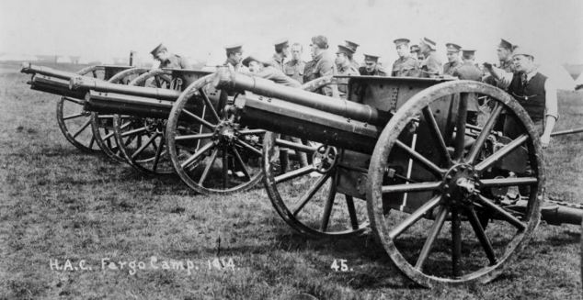
Machine Gun and Artillery field gun
Field guns fired shells that exploded when they hit something. They were large and complicated weapons to operate.
They could fire shells as far as seven kilometres and had to be placed on a flat surface. It was often difficult to find a good position for the guns because the battle field was uneven and muddy. Each field gun needed a team of between four and six men to operate them.
These guns were able to kill a lot more people more quickly.

Slide 3
Zeppelin- airplane
Airplanes were very useful during the war they are also known as blimps. They were used in German bombing raids in the war. They helped the war because people could then fly over citys and trenches in the day or night.

Slide 4
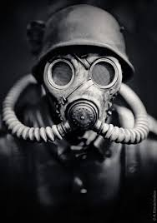
During the war people used gas masks to prevent them from suffocating if the Germans through a gas bomb in there trench. The soldiers were not the only people who wore gas masks but also town folk if they were in a place of war and danger
Gas Masks

