Slide 1
World War One

Slide 2
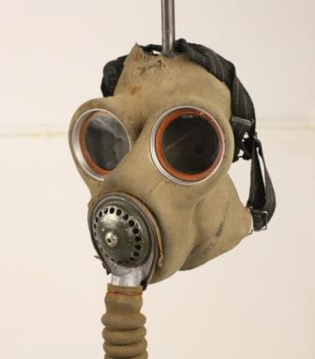
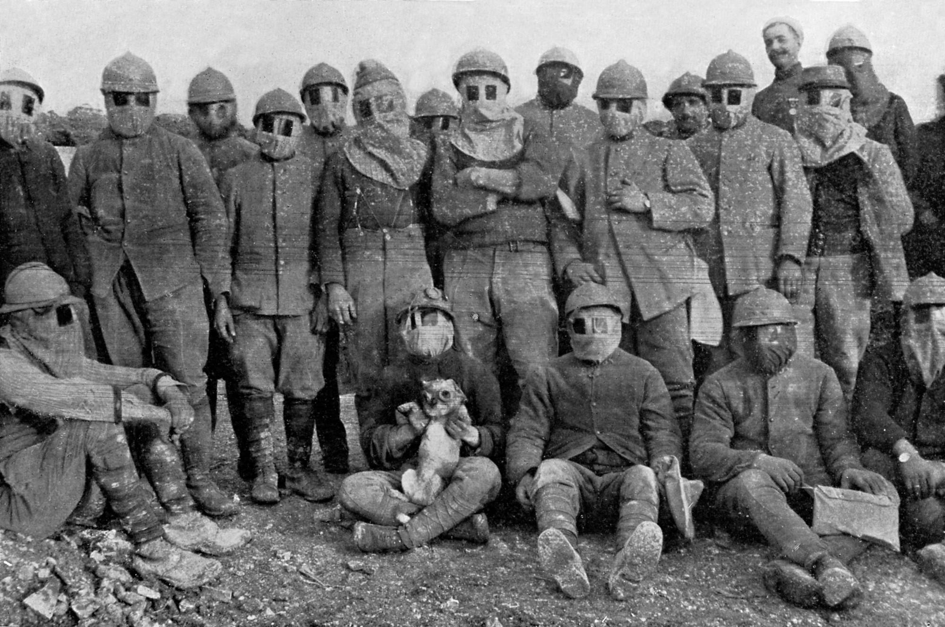
Gas masks and Gas
Gas was first used as a weapon in world war 1. Therefore gas masks were invented because gas could kill a lot of men in minutes. Gas masks helped because they were les likely to die. Animals used on the battle field also wore gas masks – especially horses.

Slide 3
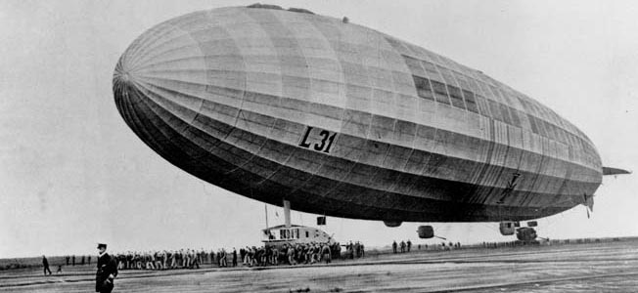
Zeppelin
Before ww1 zeppelins existed but they were not used to drop bombs. They were invented by a German inventor. They ran on hydrogen which is lighter than air so it can float. There was an underneath compartment where bombs were dropped from.

Slide 4
Tanks
Tanks were first invented in WW1.They were fist used on 15th September 1916. Britan alone produced 2600 tanks in ww1. They were very big and strong.
Sylvie and Luke

