Slide 1
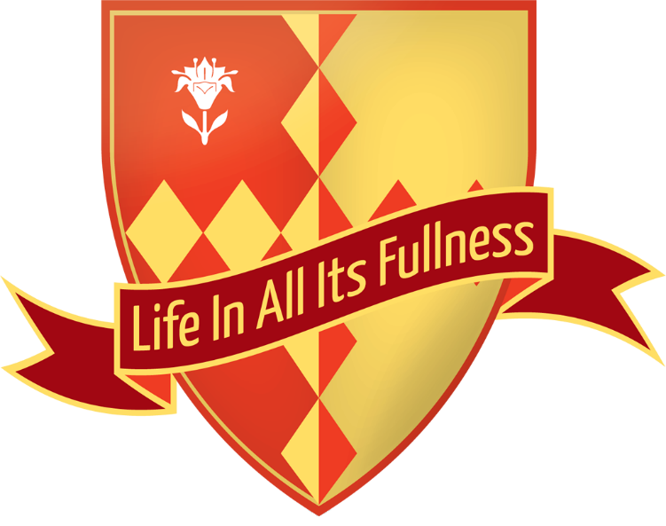
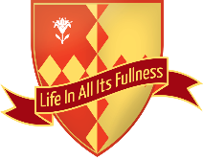
O Little Town of Bethlehem
The Cathedral School of St. Saviour and St. Mary Overie

Slide 2
O little town of Bethlehem,
How still we see thee lie.
Above thy deep and dreamless sleep,
The silent stars go by.
Yet in thy dark streets shineth,
The everlasting Light.
The hopes and fears of all the years,
Are met in thee tonight.
The Cathedral School of St. Saviour and St. Mary Overie

Slide 3
O morning stars together,
Proclaim the holy birth.
And praises sing to God the King,
And Peace to men on earth.
For Christ is born of Mary,
And gathered all above
While mortals sleep, the angels keep
Their watch of wondering love.
The Cathedral School of St. Saviour and St. Mary Overie

Slide 4
How silently, how silently,
The wondrous gift is given!
So God imparts to human hearts,
The blessings of His heaven.
No ear may hear His coming,
But in this world of sin
Where meek souls will receive him still,
The dear Christ enters in.
The Cathedral School of St. Saviour and St. Mary Overie

Slide 5
O holy Child of Bethlehem,
Descend to us, we pray.
Cast out our sin and enter in
Be born to us today.
We hear the Christmas angels
The great glad tidings tell.
O come to us, abide with us
Our Lord Emmanuel.
The Cathedral School of St. Saviour and St. Mary Overie

Slide 6
O Little Town of Bethlehem
The Cathedral School of St. Saviour and St. Mary Overie

