Slide 1
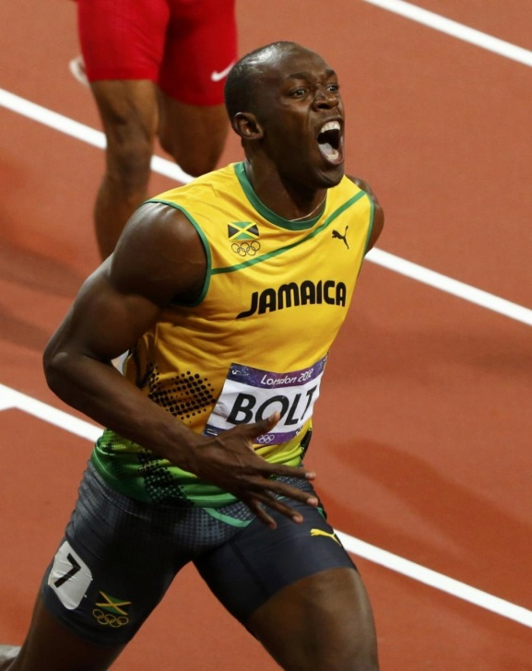
Usain Bolt
Usain Bolt was born
On the 21st of August,
1986 in Trelawny, Jamaica.

Slide 2
Usain Bolt
Usain Bolt holds the world’s record for the fastest 100m. He ran a 100m in 9.58 seconds.

Slide 3
Usain Bolt
Usain Bolt is the best athlete in Jamaica at the moment.

Slide 4
Usain Bolt
People say Usain Bolt makes Jamaica a good country.

Slide 5
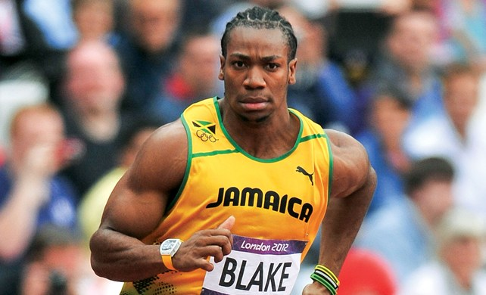
Yohan Blake
They also say that Yohan Blake is the 2nd best athlete in Jamaica at the moment. He is probably Usain Bolts rival.

