Slide 1
Curriculum Evening
Strategies For Enhancing Home Learning
Thank you for attending
Session Outcomes:
1) Maths - recommended strategies when completing addition and subtraction calculations in Year 4
2) Maths - essential times tables facts in Year 4
3) English - methodologies for learning, and applying, new spellings
4) English - strategies for improving reading comprehension

Slide 2
Please ask your child which method they are currently using in school. Ask your child to show you the method - it is often beneficial to recap what has been done successfully with children previously, before moving on. If, at any time, children are making significant errors, return to the previous year in calculation.
Curriculum Evening
Strategies For Enhancing Home Learning
School Blog
1. Our blog - you can see what the class has been up to:
http://www.cathedralprimaryschool.com/class4/
Maths blog!

Slide 3
Curriculum Evening
Strategies For Enhancing Home Learning
Session Outcomes:
1) Maths - recommended strategies when completing calculations in Year 4- understanding place value
Th H T U
Thousands Hundreds Tens Units
4 7 8 2
Understanding place value is important, so that children gain a robust mathematical understanding of what is happening throughout the calculation, rather than trying to perform a rote learned recipe.

Slide 4
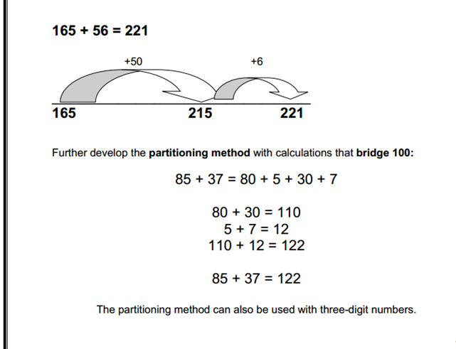
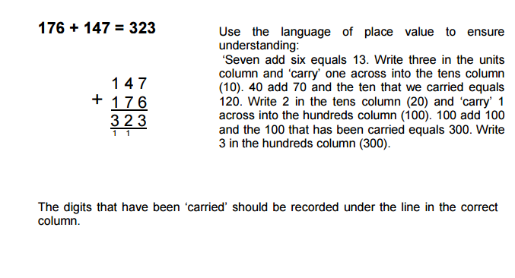
Curriculum Evening
Strategies For Enhancing Home Learning
Session Outcomes:
1) Maths - recommended strategies when completing addition calculations in Year 4
Focus: Add numbers with up to four digits
+10
+10
+10
+10
+4
78
88
98
108
118
122
78+44 = 122
1085 + 1037 = 2122
1000 + 1000 = 2000
80 + 30 = 110
5 + 7 = 12

Slide 5
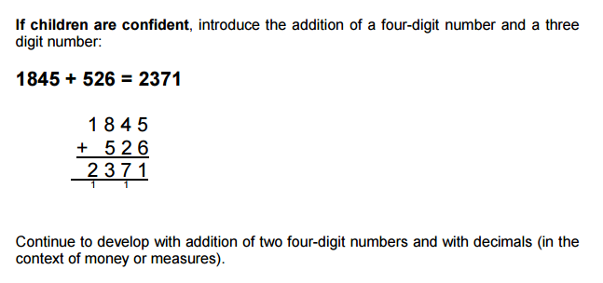

Slide 6
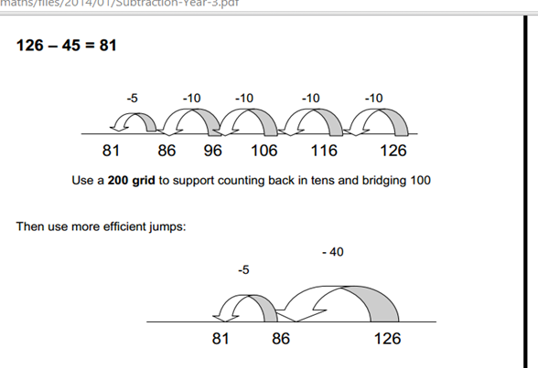
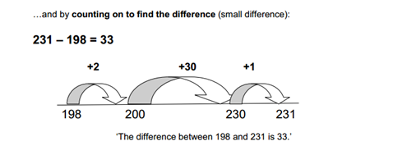
Curriculum Evening
Strategies For Enhancing Home Learning
Session Outcomes:
1) Numeracy - recommended strategies when completing subtraction calculations in Year 4
209 - 188 = 21
+2
+10
+ 5
+4
188 190
200 205 209

Slide 7
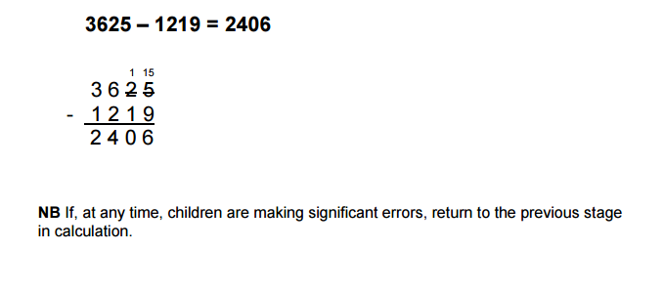
Exchange!

Slide 8
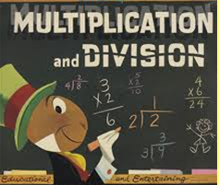
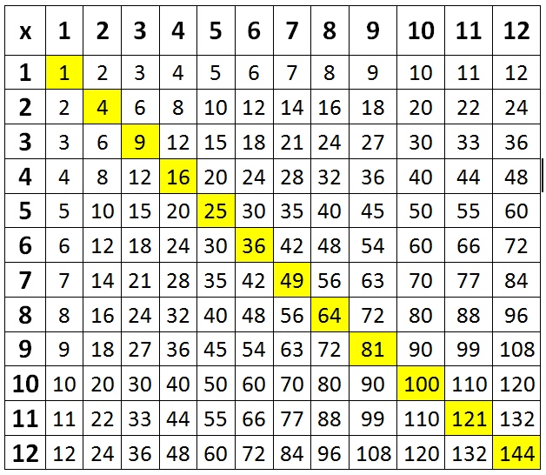
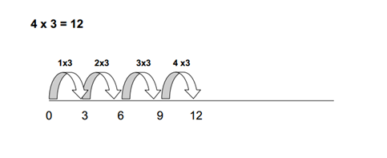
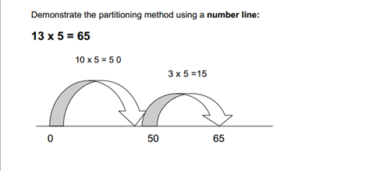
Curriculum Evening
Strategies For Enhancing Home Learning
Session Outcomes:
2) Numeracy - essential times tables facts in Year 4
Key Point
Pupils need to know multiplication tables up to 12 × 12 and corresponding division facts.
9 x 9 = 81 81
9 = 9
1. Repeated addition
0
3
6
9
12
14 x 3 = 42
0
30
33
36
39
42

Slide 9
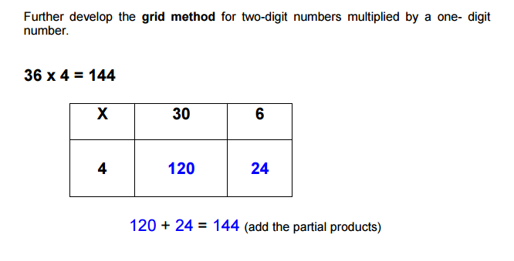
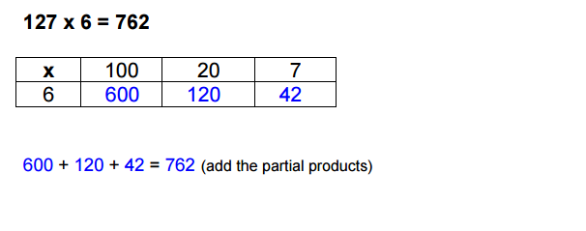

Slide 10
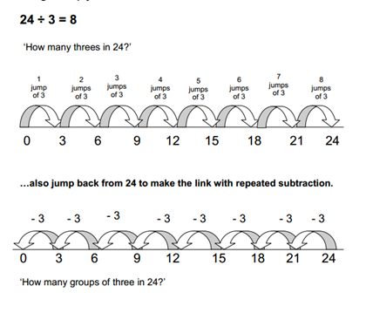
Division

Slide 11
Curriculum Evening
Strategies For Enhancing Home Learning
Session Outcomes:
2) Numeracy - essential times tables facts in Year 4
Key Point
Test questions will usually be written as word problems, so pupils need to apply their multiplication knowledge to problem solving questions.
A worker was paid £7
for 7 hours work, how
much were they paid?
General tips
Money
Talk about prices when you are shopping, pointing out the way in which they are written on supermarket shelves. Ask your child to help you to work out the value of ‘money off’, half price or ’3 for 2′ special offers.
Time
Help your child to tell the time using clocks with hands (analogue clocks). This is useful in practising fractions (halves and quarters) and numbers to 60.
Read digital clocks together and talk about the times displayed. Share everyday examples of digital times, such as reading a bus or train timetable, or setting a video recorder
Practise fractions as you cut sandwiches into halves or quarters
Encourage your child to tell you about the number work s/he is doing at school

Slide 12
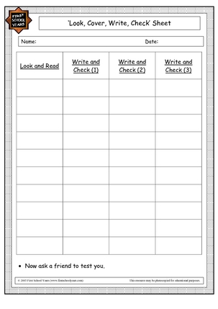
Curriculum Evening
Strategies For Enhancing Home Learning
Session Outcomes:
3) English - methodologies for learning, and applying, new spellings
What do all these words have
in common?
Can you think of a rule that we
could use to remember how to
spell these words?
Are there any words that have a
similar sound but a different
spelling pattern?
vision
invasion
mansion
erosion
pension
revision

Slide 13
Curriculum Evening
Strategies For Enhancing Home Learning
Session Outcomes:
3) English - methodologies for learning, and applying, new spellings
Key Point
Children applying their spelling words into a sentence gives the children a deeper
understanding of the meaning of
the word and an example of a
context to use it in.
vision
invasion
mansion
erosion
pension
revision
The seaside along the Devonshire
coastline was suffering from severe
erosion after the recent storms.

Slide 14
Curriculum Evening
Strategies For Enhancing Home Learning
Session Outcomes:
4) English - strategies for improving reading comprehension
Children are read weekly at least once with myself
Books are changed weekly
Ideally children are read with at home x4 times each week - please write in the reading record book when you hear them read.
It is important that children not only read the words on the page, but also understand and enjoy books.
The ability to read and understand texts greatly enhances children’s chances of achieving across the curriculum, encouraging them to become more independent in finding information as well as extending their knowledge and developing their vocabulary.

Slide 15
Curriculum Evening
Strategies For Enhancing Home Learning
Key Point - inferential skills enhance pupil's comprehension skills
It is beneficial to pay close attention to what pupils can infer about plot/characters/settings/etc from reading the text and closely analysing the author's use of language.
Question examples
1.What makes you think that?
2.What words give you that impression? Why?
3.Why was (character name) important to the story?
4. What words inform us about the emotions of the characters?
5. What have we learnt about the characters from reading this passage?
6. What words and phrases capture your imagination?
Session Outcomes:
4) English - strategies for improving reading comprehension

Slide 16
Curriculum Evening
Strategies For Enhancing Home Learning
Key Points to remember:
Session Outcomes:
1) Maths - recommended strategies when completing addition and subtraction facts in Year 4
2) Maths - essential times tables facts in Year 4
3) English - methodologies for learning, and applying, new spellings
4) English - strategies for improving reading comprehension

