Slide 1
WW1 WEAPONS AND COMMUNICATION.
By Aldous and anish.

Slide 2
Gas Masks
Gas attacks could permanently damage a soldiers breathing and eyesight so gas masks were essential to a soldiers survival, many people still died because they didn’t get to their gas mask in time so the gas invaded their body until they died.

Slide 3
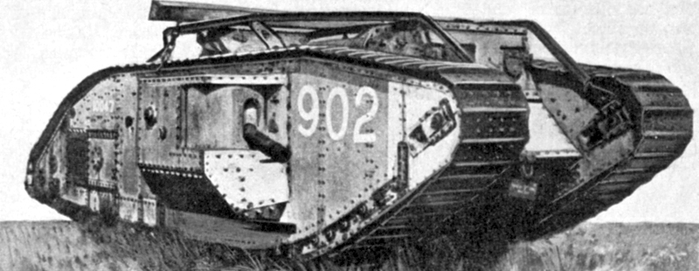
Tanks
The tank first appeared in the Battle of Flers, Courcellete, 15th september1916 in France. By the end of WW1 the were 2,600 tanks that had been produced. Britain then used a different type of tank in WW2, the shape and guns were modified to ensure a better death-rate. The tank was revolutionary because you could cross No-Man’s-Land with a higher chance of survival.

Slide 4
Rifle
The rifle was the most commonly used weapon in WW1. They were single shot guns as sub-machine-guns had not been invented. (They were made in WW2). They had a small bayonet on the end of them. They were commonly used if you were going in to close combat in the enemy’s trenches.

Slide 5
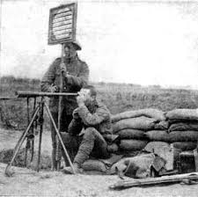
Signalling post
Signalling posts were stationed at the frontline and two men reported on how the battle was going. The men at the post would use morse code so the enemy could not decipher their message. They are no longer used as phones are available.

