Slide 1
World War One Communication
By Glenda and Mrinali

Slide 2
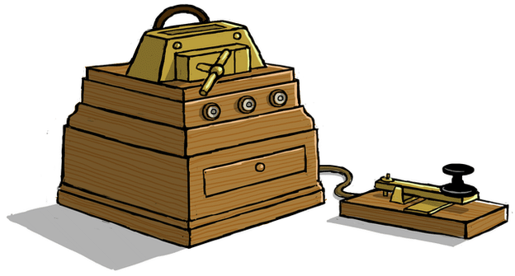
Letters, Signalling Post, Morse code and Telephones
In World War One there were lots of ways for people to communicate.
The Telegraph Machine
The telegraph machine was used for taping messages throughout the day. Before telephones were common it was the fastest way to send important information to others. It was an impact to World War One because those soldiers on the front line were able to communicate with the other soldiers and with people at home.
This is a picture of the telegraph machine at the time.

Slide 3
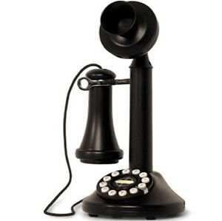
Letters, Signalling Posts, Morse Codes and Telephones
Telephones
When the telephone came out, they were used by several people instead of the telegraph machine because it was much cheaper and much more fast to use for sending significant information and the telegraph machine was truly expensive. It was an impact to the war because it made soldier’s life easier to connect to others.

Slide 4
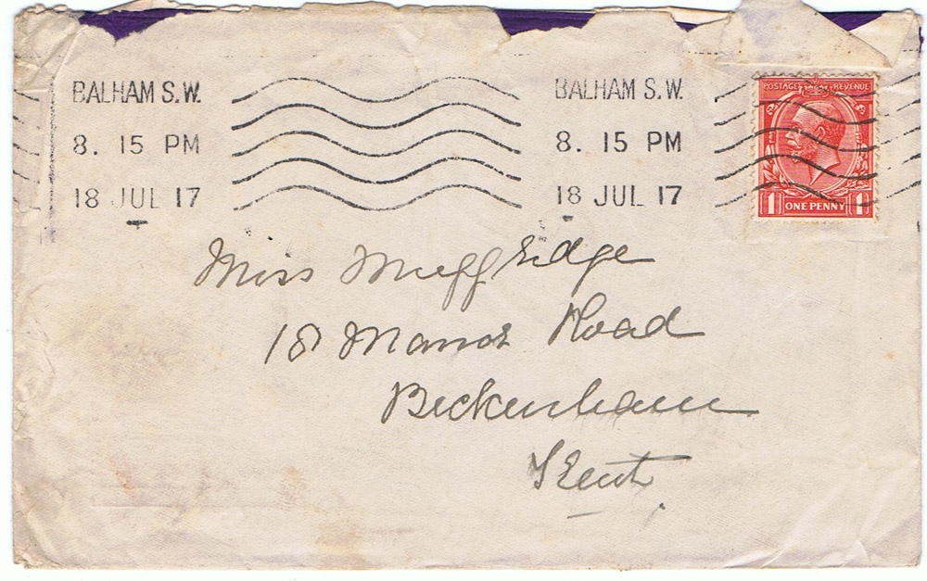
Letters, Signalling Posts, Morse Codes and Telephones
Letters
To keep in touch with friends and businesses, letters as well as postcards were generally used. During the war, a number of soldiers sent these overseas to their families or businesses to communicate with them. Until the last year of the war, letters cost just a penny. Once the war had started deliveries had reduced from twelve to one or two a day.

