Slide 1
WW1
By Jimmy

Slide 2
Machine Gun, Artillery field gun and rifle bayonet.
Machine guns fired up to 600 bullets in a minute and were very dangerous. Many soldiers dreaded the enemy soldiers who operated machine guns more than anyone else.It could fire 15 rounds in under a minute and reach a target over a 1,000 metres away.
Sometimes a bayonet (a sword-like blade) was fixed to rifles and used for one-on-one fighting. Some soldiers also used their bayonet to open tin cans and scrape mud off their boots.
Artillery Field Guns could fire shells as far as seven kilometres and had to be placed on a flat surface. It was often difficult to find a good position for the guns because the battle field was uneven and muddy. Each field gun needed a team of between four and six men to operate them.

Slide 3
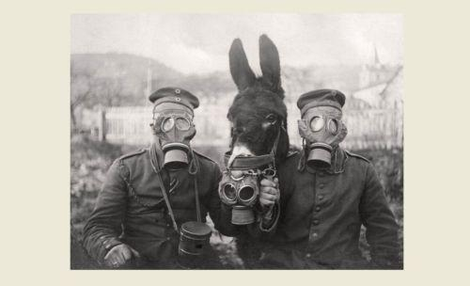
Gas Mask
Gas could affect a person's sight and breathing in just a few minutes so protective masks were given to all soldiers.
As shown in the photograph, many working horses and mules also wore gas masks. These were specially designed for them during the war.

Slide 4
Tanks and their impact
By the summer of 1918 they were commonly used on the front line. Britain produced around 2,600 tanks during World War One.
Tanks rumbled onto the battlefield for the first time on the 15th September 1916. Both the German and British soldiers were shocked to see them.

Slide 5
Zeppelin airplain
Aeroplanes were very recent inventions when World War One broke out. As aircraft technology developed, planes became very important to the war.
France only had 140 aircraft when war began but by the end of it, they had used around 4,500.

Slide 6
MOSE code
A man, or group of men, would be based at a signal post close to the front line.
They would use a light signal; a light or mirror which was held up to send messages in Morse code back to base.
The men operating signalling posts would watch the battle and report what they saw.

