Slide 1
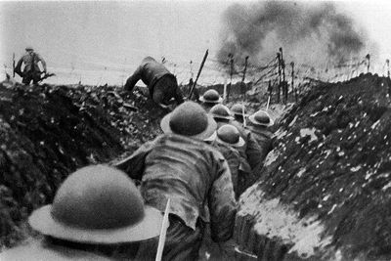
What weapons and communication they used in WW1 By Leon and Samuel Lee

Slide 2
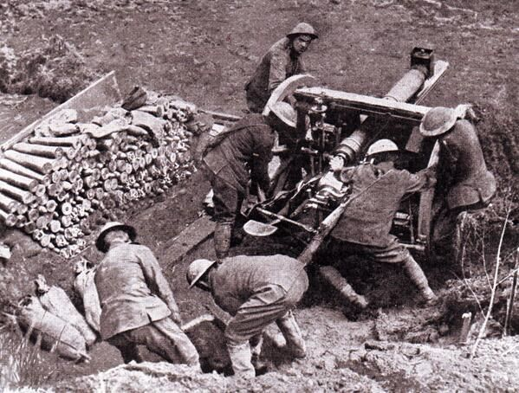
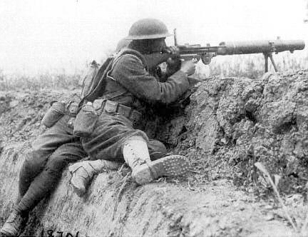
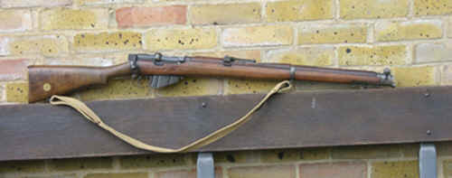
Fire Power
Rifle
It has a range of 1000 metres and it shoots 15 rounds in under a minute. If the soldier has to fight in melee they stick a bayonet on the end of the barrel. The rifles were first used in the 1800s.
Machine gun
They are big and heavy and needs six people to control it . They were largely used on the Weston front and fired 600 bullets a minute. They were the most dreaded thing on the battle field. The machine gun could kill more people by constant fire.
Artillery
Artillery fired explosive shells and shrapnel shells (exploded and fires out small pieces of metal. They could only be operated on flat ground and had a range of seven kilometres. The field gun could kill more people because of it’s area of attack.

Slide 3
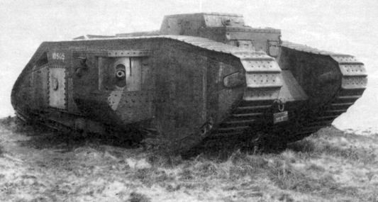
Tanks and their impact
The British first operated with tanks in 15 September 1916. By the end of the war the British had produced 2600. The first tank was called the Mark I soon to be followed by the Mark II. It had a high speed around 5 miles an hour. These two types of tanks had a huge impact on the war. Even though the people working in them had a very low chance of survival, it was used as a shield against gun fire for the infantry. It was also a moving artillery gun. It made it possible to get a decently accurate shot with big artillery guns because they could get a lot closer. The French and the Germans made their own tanks based on the Marks, but the best tank in the war was the Mark V.

