Slide 1
Machine guns

Slide 2
Rifle
The rifle was one of first weapons used in WW1. Its furthest range was 1,000 metres away. It could fire up to fifteen rounds in a minute, which was very fast back then! Normally a sword would be stuck on for extra aim and for one on one fighting. The sword was very useful for opening tins and getting mud of shoes and boots. The impact this had was that only one man could carry it and it still could kill loads.
Here is a picture of a rifle:

Slide 3
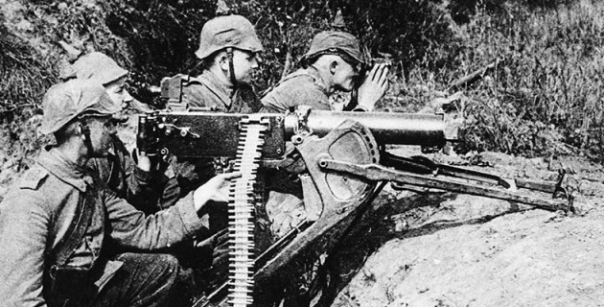
Machine gun
Machine Guns were very useful in WW1 and killed millions of people. They fired up to 600 bullets in a minute. That means that a bullet could be shot every 0.1 seconds. In battle people normally feared the machine gun firers the most since they have the best shot ratio and were the most powerful gun at the time. Despite them being powerful, they are extremely difficult operate especially with only one person the gun. Most of the time there are about six people at the gun. This was very important to the war because it killed millions of people in quick succession.
Here is a picture of the Machine Gun:

Slide 4
Difference between rifle and machine guns
The difference between rifles and machine guns is humongous gap. The machine gun fires 600 bullets in a minute compared to a rifle which shoots 15 bullets in a minute. The rifle may only need one person compared to 6 but it is less powerful by a huge mile.

Slide 5
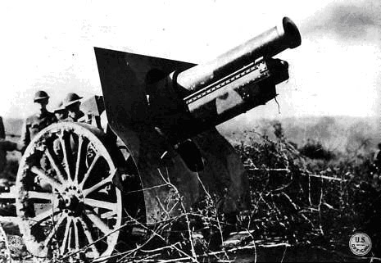
Artillery field gun
Field guns didn’t fire bullets but the fired shells. When the shells hit something the would explode and cause the object to explode. There weren’t many artillery field guns because the ground was so thick, muddy and bumpy causing the gun to get stuck or not get to its destination quick enough before someone explodes it. It can shoot up to 7 kilometres. This had a massive impact on the war because it could shoot up to 7 kilometres and it exploded when it hit something.
Here is a picture of the artillery field gun:

Slide 6
GAS AND GAS MASKS

Slide 7
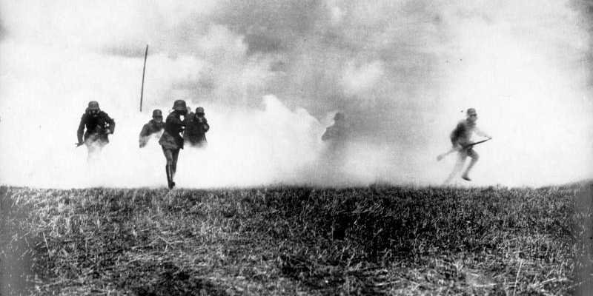
GAS
Gas was used a lot in WW1 when the army was invading a trench. It killed peoples lungs making it hard to breathe and survive. It was a very good weapon if you were using it but it wouldn’t be very funny if you were on the receiving end. This was a very good weapon for WW1 and it killed a lot of people.
Here is a picture of gas:

