Slide 1
ZEPPELINS & AIRPLANES
WW1

Slide 2
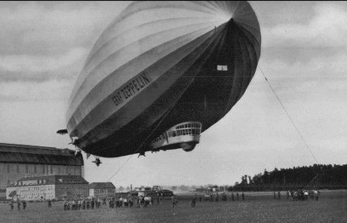
France only had 140 aircraft when war began but by the end of it, they had used around 4,500. They used these zeppelins before they had airplanes, which made a huge difference. The zeppelin was named after German Count Ferdinand van Zeppelin. The first flight lasted about 18 minutes and covered about 3-1/2 miles over a lake.

Slide 3
What zeppelins are made of?
The ship was inflated with hydrogen gas in June and made its maiden flight on July 2, 1900. The first flight lasted about 18 minutes and covered about 3-1/2 miles over a lake.

Slide 4
What happened to zeppelins?
A Zeppelin was a type of rigid aircraft named after the German Count Ferdinand van Zeppelin. After the outstanding success of the Zeppelin design, the word zeppelin came to be commonly used to refer to all rigid airships. The zeppelins have been taken out of the air due to an explosion that destroyed the Hindengburg on 6 May 1936.
This really helped in the war because they could fly and drop bombs easily but I think that you could easily see them.

Slide 5
Signalling flags were normally in blue and white. There were variations in the length of the poles and the size and material from which the flags were made. These variations affected the speed at which the operators could send their message. Silk (l flags, with which an able operator could reach about 12 words per minute , were used to send the fastest messages.

