Slide 1
World War I
By Oscar and Emil

Slide 2
Gas Mask
Poisonous gas was used as a new weapon in WW1. Gas Masks helped soldiers survive gas bombs and attacks in WW1. Gas could affect a person's sight and breathing in just a few minutes so protective masks were given to all soldiers. 1 gas attack could kill several men in WW1.
This is a picture of a gas mask.

Slide 3
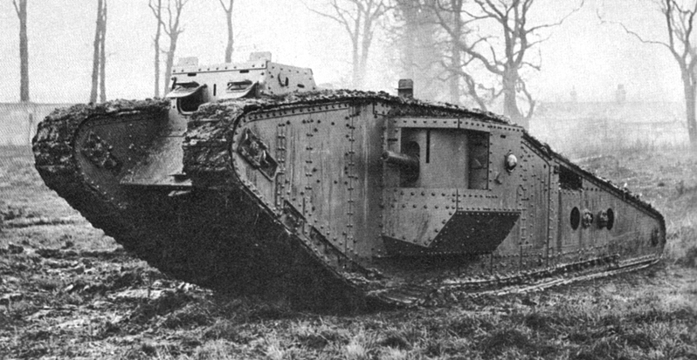
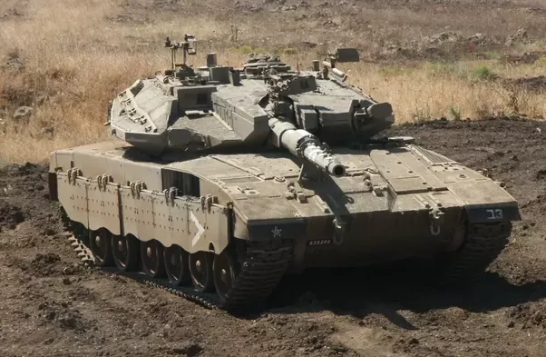
Tank
Britain used tanks in battle for the first time on 15 September 1916. They were used because the soldiers needed to cross No Mans Land more safely than normal.
Olden day tank (top)
Morden day tank(bottom)

Slide 4
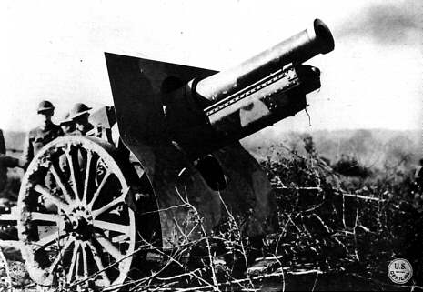
Artillery Field Gun
Field guns fired shells that exploded when they hit something. They could fire shells as far as seven kilometres and had to be placed on a flat surface. It was often difficult to find a good position for the guns because the battle field was uneven and muddy. You had to have between 4 and 6 men to operate the gun.
This is an Artillery Field Gun.

Slide 5
Machine Gun
Machine guns were very big and heavy and needed up to six people to operate them. They were placed all along the Western Front. Machine guns fired up to 600 bullets in a minute and were very dangerous.
This is a picture of two men firing a machine gun.

Slide 6
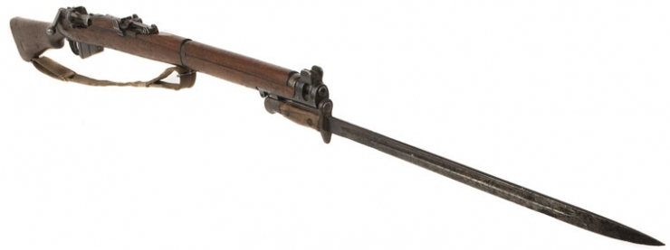
Rifle and Bayonet
Almost every soldier had his own rifle. It could fire 15 rounds in under a minute and reach a target over a 1,000 metres away. Sometimes a bayonet (a sword-like blade) was fixed to rifles and used for one-on-one fighting.
This is a picture of a rifle and bayonet.

Slide 7
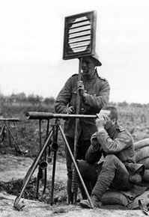
Signalling Posts
A man, or group of men, would be based at a signal post close to the front line. They would use a light signal, a light or mirror which was held up to send messages in Morse code back to base. The men operating the signalling posts would watch the battle and talk to the soldiers about what they saw.
This is a picture of two men signalling to men in the battle.

Slide 8
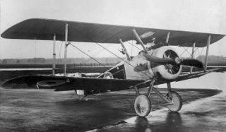
Airplane
Aeroplanes were very recent inventions when World War One broke out. As aircraft technology developed, planes became very important to the war. France only had only a few aircrafts when war began but by the end of it, they had used around 4,500.
This is a picture of an airplane in WW1

